Slide 1
G.L. CHRISTINA MARTHA
Assistant professor
Department of English
Jamal Mohamed college
Poem : My Grandmother’s House by Kamala Das
Poetry and Drama UG

Slide 2
MY GRANDMOTHER’S HOUSE
- KAMALA DAS

Slide 3
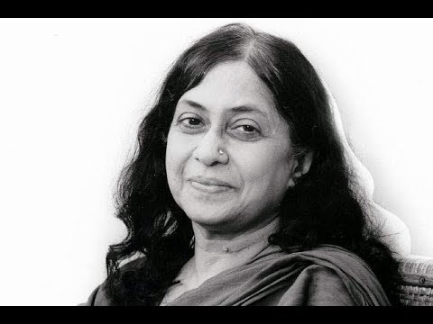
Kamala das

Slide 4
INTRODUCTION
Kamala Surayya (born Kamala; 31 March 1934 – 31 May 2009), popularly known by her one-time pen name Madhavikutty and married name Kamala Das, was an Indian poet in English as well as an author in Malayalam from Kerala, India. Her popularity in Kerala is based chiefly on her short stories and autobiography. Her open and honest treatment of female sexuality, free from any sense of guilt, infused her writing with power and she got hope after freedom, but also marked her as an iconoclast in her generation. On 31 May 2009, aged 75, she died at a hospital in Pune.

Slide 5
INTRODUCTION OF THE POEM
The poem My Grandmother’s House is written by Kamala Das. The poem has been written in the memory of her grandmother with whom she had spent her childhood.
The poet considers those moments to be the best moments of her life and desires to get them. She also mourns their loss.

Slide 6
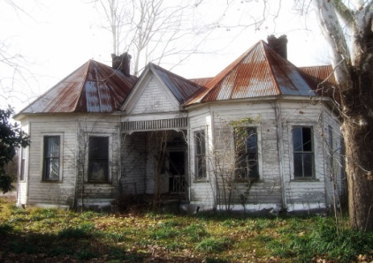
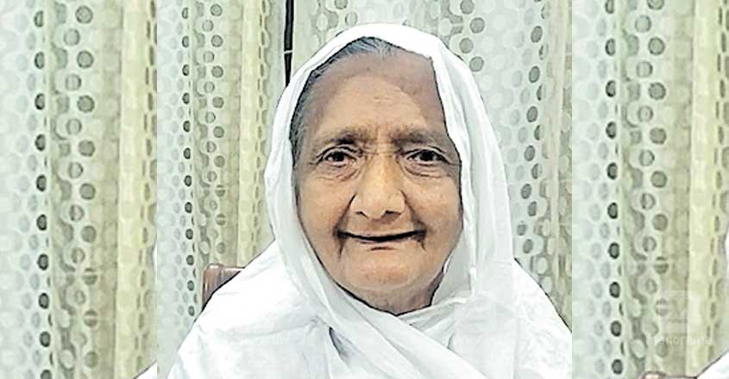
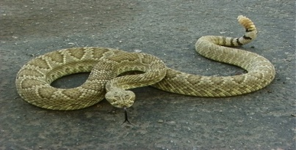
MY GRANDMOTHER'S HOUSE
BY KAMALA DAS
There is a house now far away where once
I received love……. That woman died,
The house withdrew into silence, snakes moved
Among books, I was then too young

Slide 7
Reminiscence (tending to remind one of something.)
At the beginning of the poem, the poet says that there is a home that is now very far from her where she received love. It was the house of her grandmother in which she spent the days of her childhood.
However, that woman, (her grandmother) is dead now and the home “withdrew in silence” i.e. is without any life because her grandmother was the very soul of it.
Grandmother also had books which she could not read as he was quite young and she would read stories for her (poet). But now the snakes are moving in those books. All these things made the house quite horrible and the poet “like the moon” i.e. quite unhappy. She is now without any life and warmth.

Slide 8
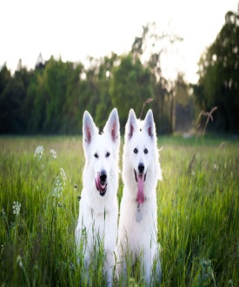
To read, and my blood turned cold like the moon
How often I think of going
There, to peer through blind eyes of windows or
Just listen to the frozen air,
Or in wild despair, pick an armful of
Darkness to bring it here to lie
Behind my bedroom door like a brooding

Slide 9
Desire
The poet expresses her desire to go to her grandmother’s house because she is emotionally attached to it since her childhood. She wants to look through the “blind eyes of windows” of her grandmother’s house.
The term “blind eyes of windows” means that there is no one (in other words, her grandmother) in the house to look for. She also desires to listen to “the frozen air” of that house. “Frozen Air” probably means that that the house is locked and the fresh air has not moved in.
In my views, the poet desires to move into her thoughts which are buried deep inside her heart and no air has blown into it. Thus the grandmother’s house here is rather a sweet memory that she wants to recall.
The poet further says that she wants to bring the darkness of her grandmother’s house with her “in wild despair” i.e. in her troubled life.
The line makes it clear that her grandmother was very protective. And now that she feels insecure, even the darkness of her grandmother’s house, which is though unpleasant like cold moon comforts her.

Slide 10
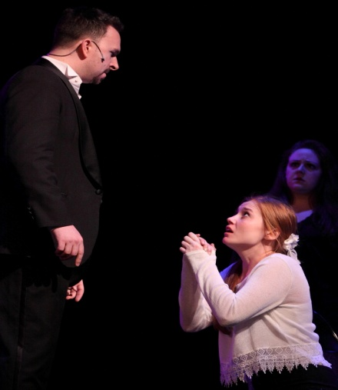
Dog…you cannot believe, darling,
Can you, that I lived in such a house and
Was proud, and loved…. I who have lost
My way and beg now at strangers' doors to
Receive love, at least in small change?

Slide 11
Begging for Love
In the final lines, the poet is in conversation probably with her husband or her readers. The poet says that one won’t believe that she had some of the best memories of her grandmother’s house and she is quite proud of it.
Now that she has lost her grandmother, she begs at strangers’ doors for love. She knows well that you won’t be able to get that much love but she still hopes for at least a part of it.
Hence the poet ends with hope and despair.

